Slide 2
Unit 5: Probability Concept and Random Numbers (7 hrs)
5.1 Stochastic System
5.2 Discrete and Continuous Probability Function
5.3 Random Numbers Versus Pseudo Random Numbers
5.4 Properties of Random Numbers
5.5 Random Number Generation Techniques
5.5.1 Linear Congruential Generator
5.5.2 Mixed Generator
5.5.3 Additive and Incremental Generator
5.6 Test for Randomness
5.6.1 Uniformity Test (KS Test, Chi Square Test)
5.6.2 Independence Test (Run Test (Above and Below, Up and Down, Lengths of Runs), Test for Auto Correlation, Gap Test, Poker Test)

Slide 3
Test for Randomness
A sequence of random number is considered to be random if
The number are uniformly distributed i.e. every number has an equal chance of occurrence.
The number are not serially auto-correlated i.e. there is no correlation between adjacent pair or number, or the appearance of one number doesn’t influence the appearance of next number.
There are a number of test, which are used to ensure that random numbers are uniformly distributed and are not serially auto-correlated.

Slide 4
Test for Randomness
Uniformity Test (Frequency Test)
Kolmogorov-Smirnov test (K-S Test): Compares the cumulative distribution function (CDF) of the observed data with the uniform distribution.
Chi-Square Test: Compares the observed frequency of numbers falling into bins with the expected frequency.
Independence Test
Runs Test: Checks for non-random sequences above or below the mean
Auto Correlation Test: Measures correlation between elements at fixed lags
Gap Test: Measures the number of values between repetitions of numbers in a certain range.
Poker Test

Slide 5
Uniformity Test (Frequency Test)
The test of uniformity or frequency test is a basic test that should always be performed to validate a random number generator.
The uniformity test counts how often numbers in a given range occur in the sequence to ensure that the number are uniformly distributed.
Two frequency test are available, and they are
Kolmogorov-Smirnov test
Chi-Square test

Slide 6
Uniformity Test (Frequency Test)
Both of these test compare the generated random number with the theoretical uniform distribution. The algorithms of testing a random number generator are based on some statistics theory, i.e. testing the hypotheses.
We have two hypotheses one says the random number generator is indeed uniformly distributed. We call this H₀, known in statistics as null hypothesis.
The other hypothesis says the random number generator is not uniformly distributed. We call this H₁, known in statistics as alternative hypothesis.
We are interested in testing result of H₀, reject it, or fail to reject it.

Slide 7
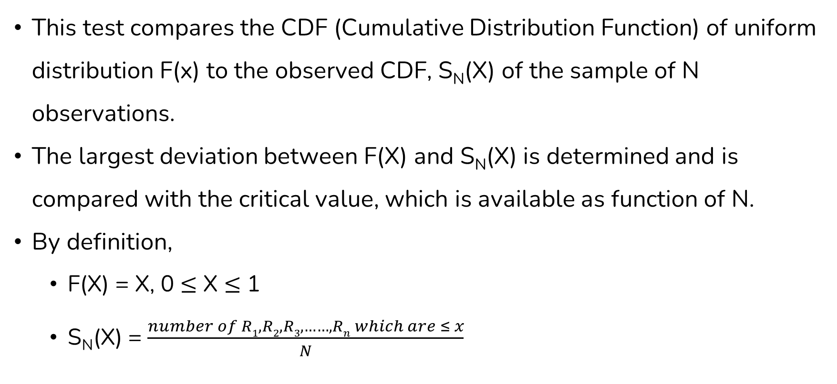
K-S Test
This test compares the CDF (Cumulative Distribution Function) of uniform distribution F(x) to the observed CDF, S_{N}(X) of the sample of N observations.
The largest deviation between F(X) and S_{N}(X) is determined and is compared with the critical value, which is available as function of N.
By definition,
F(X) = X, 0 $≤$ X $≤$ 1
S_{N}(X) = $\frac{number of R1, R2, R3, ……, Rn which are ≤ x}{N}$

Slide 8
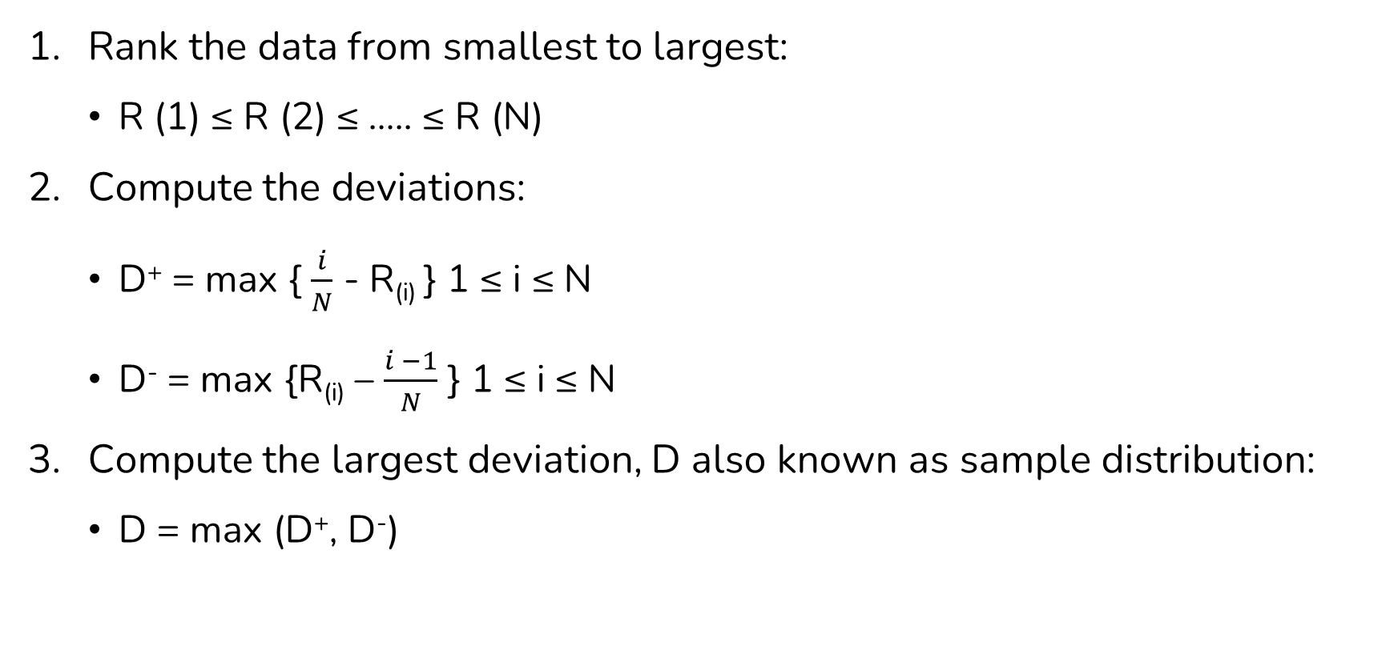
Procedure of applying K-S Uniformity Test
Rank the data from smallest to largest:
R (1) ≤ R (2) ≤ ….. ≤ R (N)
Compute the deviations:
D⁺ = max { $\frac{i}{N}$ - R_{(i)} } 1 ≤ i ≤ N
D⁻ = max {R_{(i)} – $\frac{i −1}{N}$ } 1 ≤ i ≤ N
Compute the largest deviation, D also known as sample distribution:
D = max (D⁺, D⁻)

Slide 9
Procedure of applying K-S Uniformity Test
Determine the critical value Dα, from the critical value table for the specified significance level α and the given sample size N.
Compare the value of D and Dα:
If D > Dα, the null hypothesis that the data are a sample from a uniform distribution is rejected.
If D ≤ Dα then there is no difference detected between the true distribution of {R₁, R₂ …R_{N}} and the uniform distribution. So, it is accepted.

Slide 10
K-S Test Example
Suppose 5 generated numbers are 0.44, 0.81, 0.14, 0.05, and 0.93. It is desired to perform a test for uniformity using the Kolmogorov-Smirnov test with a level of significance α = 0.05.
Solution:
N=5; i=1, 2, 3, 4, 5
Step 1:
Step 2:
Arrange R_{i} from smallest to largest
R_{i} | 0.05 | 0.14 | 0.44 | 0.81 | 0.93
i / N | 0.20 | 0.40 | 0.60 | 0.80 | 1.00
i / N - R_{i} | 0.15 | 0.26 | 0.16 | - | 0.07
R_{i} – [(i-1)/N] | 0.05 | - | 0.04 | 0.21 | 0.13
D⁺
D⁻

Slide 11
K-S Test Example
Suppose 5 generated numbers are 0.44, 0.81, 0.14, 0.05, and 0.93. It is desired to perform a test for uniformity using the Kolmogorov-Smirnov test with a level of significance α = 0.05.
Solution:
Step 3: D = max (D⁺, D⁻) = 0.26
Step 4: For α = 0.05, N = 5 Dα = D_{0.05} = 0.565 (from table of critical value) D < Dα → 0.26 < 0.565.
Therefore, H₀ is not rejected, i.e. no difference between the distribution of generated numbers and the uniform distribution.

Slide 12
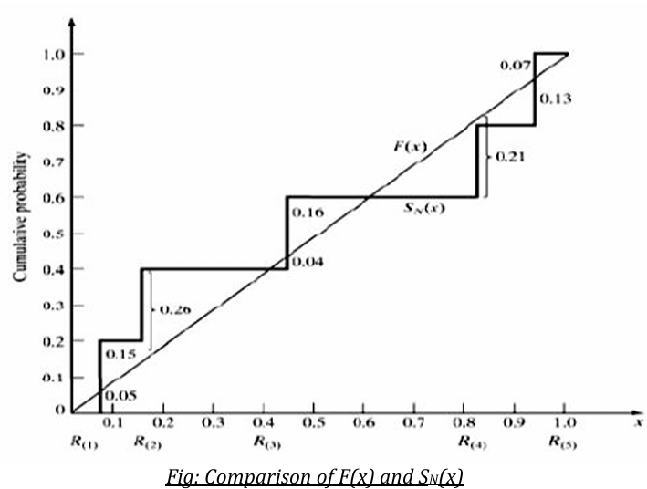
K-S Test Example
The calculations in the above table are depicted in the figure below, where empirical cdf SN(x) is compared to uniform cdf F(x).
It is seen that D⁺ is the largest deviation of S_{N}(x) above F(x) and D⁻ is the largest deviation of S_{N}(x) below F(x).

Slide 13
K-S Test Question 1
The sequence of number 0.24, 0.89,0.11, 0.61, 0.23, 0.86, 0.41, 0.64, 0.50, 0.65 has been generated. Use the K-S test with a level of significance α = 0.05 and D_{0.05} = 0.410 to determine if the hypothesis that the number are uniformly distributed on the interval [0,1] can be rejected.

Slide 14
K-S Test Question 1 Solution
From the above table we get,
D⁺ = Max( i / N – R_{i}) = 0.15
D⁻ = Max(R_{i} - (i-1)/N ) = 0.13
D = Max(D⁺, D⁻) = 0.15
The critical value D_{0.05} is 0.410 ( i.e. the critical value of D for α = 0.05 and N=10 is 0.410).
Since D<Dα, there is no chance to reject the hypothesis that the given random numbers are uniform. (or, since the computed value is less than critical value, the given random numbers are uniform at 95% level of significance).

Slide 15
K-S Test Question 2
The sequence of number 0.54, 0.73, 0.98, 0.11 and 0.68 has been generated. Use the K-S test with α = 0.05 to determine if the hypothesis that the number are uniformly distributed on the interval [0,1] can be rejected.

Slide 16
K-S Test Question 2 Solution
From the above table we get,
D⁺ = Max( i / N – R_{i}) = 0.09
D⁻ = Max(R_{i} - (i-1)/N ) = 0.34
D = Max(D⁺, D⁻) = 0.34
The critical value D_{0.05} is 0.565 ( i.e. the critical value of D for α = 0.05 and N=5 is 0.565).
Since D<Dα, there is no chance to reject the hypothesis that the given random numbers are uniform. (or, since the computed value is less than critical value, the given random numbers are uniform at 95% level of significance)

Slide 17
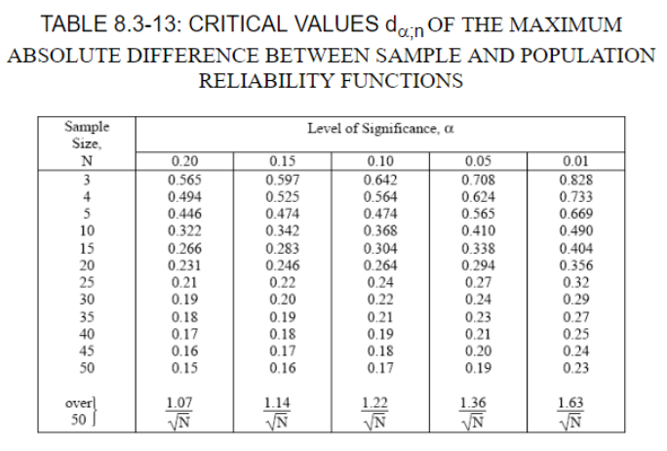
K-S Test Table

Slide 18
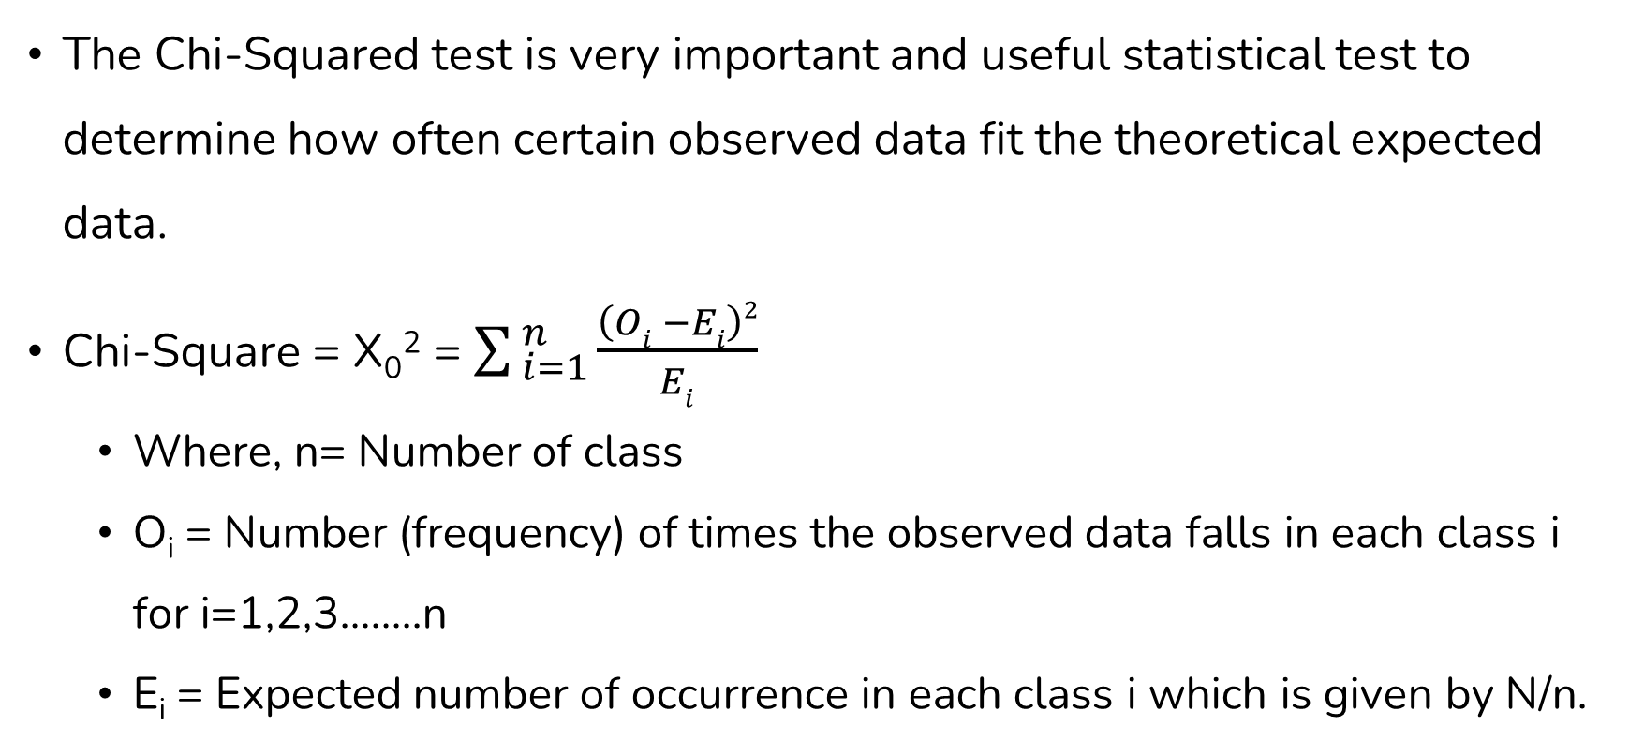
Chi Square Test
The Chi-Squared test is very important and useful statistical test to determine how often certain observed data fit the theoretical expected data.
Chi-Square = X₀² = $\sum_{ i=1}^{ n}{\frac{\left(Oi −Ei\right)2}{Ei}}$
Where, n= Number of class
O_{i} = Number (frequency) of times the observed data falls in each class i for i=1,2,3……..n
E_{i} = Expected number of occurrence in each class i which is given by N/n.

Slide 19
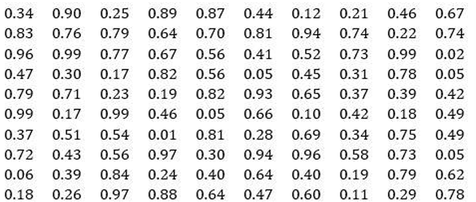
Chi Square Test Example
Use a chi-square test with α=0.05 to test whether the data shown below are uniformly distributed.

Slide 20
Chi Square Test Example
Solution:
Let n=10, the interval [0-1] can be divided in equal lengths, (0.01-0.10), (0.11-0.20), ---, (0.91-1.0)
N = 100
E_{i} = N / n = 100 / 10 = 10
The calculations are tabulated as:

Slide 21
Chi Square Test Example
Interval | O_{i} | E_{i} | O_{i} – E_{i} | (O_{i} – E_{i})² | X₀² = (O_{i} – E_{i})²
0.01 – 0.10 | 8 | 10 | -2 | 4 | 0.4
0.11 – 0.20 | 8 | 10 | -2 | 4 | 0.4
0.21 – 0.30 | 10 | 10 | 0 | 0 | 0.0
0.31 – 0.40 | 9 | 10 | -1 | 1 | 0.1
0.41 – 0.50 | 12 | 10 | 2 | 4 | 0.4
0.51 – 0.60 | 8 | 10 | -2 | 4 | 0.4
0.61 – 0.70 | 10 | 10 | 0 | 0 | 0.0
0.71 – 0.80 | 14 | 10 | 4 | 16 | 1.6
0.81 – 0.90 | 10 | 10 | 0 | 0 | 0.0
0.91 – 1.00 | 11 | 10 | 1 | 1 | 0.1
 | 104 | 100 | 0 |  | X₀² = 3.4

Slide 22
Chi Square Test Example
So, from the above table, X₀² = 3.4
Degree of freedom, df =n-1 = 10-1 =9
The critical value of X₀² obtained from Chi2 table for α =0.05 and 9 degree of freedom is 16.9.
Since X₀² < X²_{0.05, 9} , the null hypothesis of a uniform distribution is not rejected i.e. it can be accepted.

Slide 23
Chi Square Test
Note:
In general, for any value choose ‘n’ such Ei ≥ 5.
Kolmogorov-Smirnov test is more powerful than the chi-square test because it can be applied to small sample sizes, whereas chi-square requires large sample, say N ≥ 50.

Slide 24
Chi Square Test Question
Determine the Chi-square. Is it acceptable at 95% confidence level?
36, 91, 51, 2, 54, 6, 58, 6, 58, 2, 54, 1, 48, 97, 43, 22, 83, 25, 79, 95, 42, 57, 73, 17, 2, 42, 95, 38, 79, 29, 65, 9, 55, 97, 39, 83, 31, 77, 17, 62, 3, 49, 90, 37, 13, 17, 58, 11, 51, 92, 33, 78, 21, 66, 9, 54, 49, 90, 35, 84, 26, 74, 22, 62, 12, 90, 36, 83, 32, 75, 31, 94, 34, 87, 40, 7, 58, 5, 56, 22, 58, 77, 71, 10, 73, 23, 57, 13, 36, 89, 22, 68, 2, 44, 99, 27, 81, 26, 85,62

Slide 25
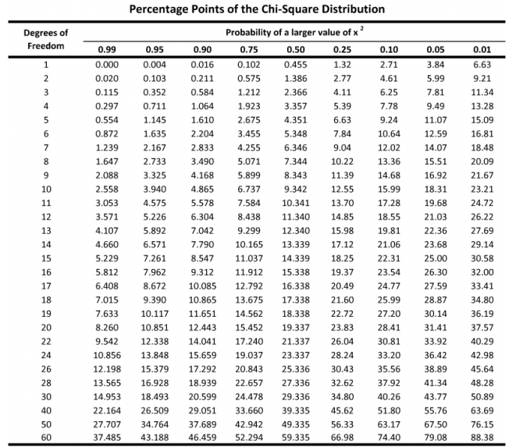
Chi Square Test Table

Slide 26
End of Lecture 16

Slide 27
Independence Test

